Slide 1
CPU
General-Purpose Micro-processor
Data Bus
Serial
COM
Port
RAM
ROM
I/O Port
Timer
Address Bus
General-Purpose Microprocessor System
CPU
RAM
ROM
Serial COM Port
Microcontroller
I/O Port
Timer
Example：Motorola’s 6811, Intel’s 8051, Zilog’s Z8 and PIC 16X

Slide 2
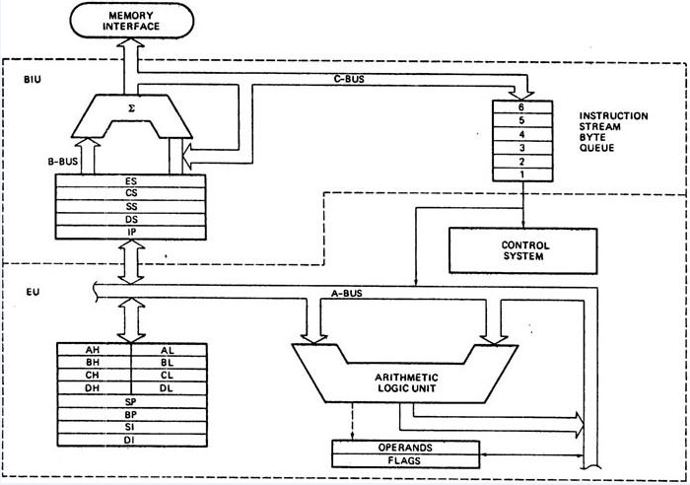

Slide 3
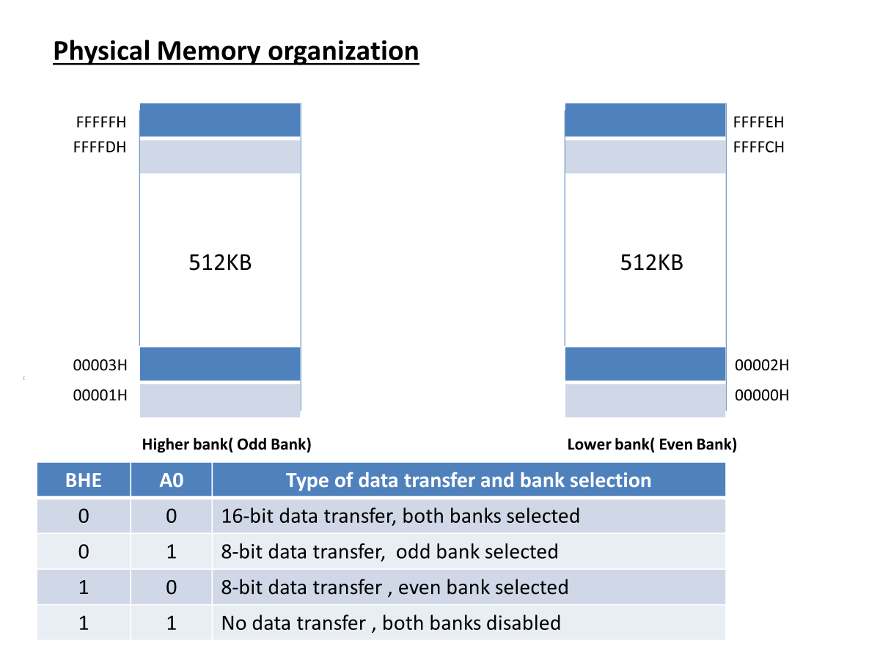

Slide 4
External interrupts
On-chip ROM for program code
Timer/Counter
Interrupt Control
On-chip RAM
Timer 1
Counter Inputs
Timer 0
CPU
Bus Control
Serial Port
4 I/O Ports
OSC
P0 P1 P2 P3
TxD RxD
Address/Data

Slide 5
Microcontroller
4KB bytes on-chip program memory (ROM)
128 bytes on-chip data memory (RAM)
Four register banks
8-bit bidirectional data bus
16-bit unidirectional address bus
32 general purpose registers each of 8-bit
16 bit Timers (usually 2, but may have more or less)
Three internal and two external Interrupts
Four 8-bit ports,(short model have two 8-bit ports)
16-bit program counter and data pointer
8051 may also have a number of special features such as UARTs, ADC, Op-amp, etc.

Slide 6
Applications of Microprocessors
Microprocessors are used where high computational power is required.
Personal computers
Laptops
Servers
Gaming consoles
Industrial automation systems

Slide 7
Applications of Microcontrollers
Microcontrollers are designed for embedded systems, where control and interfacing are more important than raw computing power.
Home appliances (Washing machines, Ovens, Smart TV, AC, ….)
Automotive systems (Airbags, Engine control unit, ….)
Consumer Electronics (Camera, Printer, Smart Watch, …)
Industrial Automation (Motor Controller, Process control, …)
Medical Equipment (ECG Monitors, BP Monitors, Ventilators, …)
IoT and Smart Devices (Smart Home, Smart Lighting, Weather Station, Security System, Environment monitoring, …)
Robotics (Drone, Robot arms, Line following robots, …)

Slide 8
Difference Between Microprocessor and Microcontroller
Feature | Microprocessor | Microcontroller
CPU | Only CPU on chip | CPU + Memory + Peripherals on one chip
Memory | External | Mostly internal
GPIO | External | Built-in
ADC/DAC | Usually external | Often built-in
Timers | External | Built-in
Cost | Higher | Lower
Power Consumption | Higher | Lower
Speed | Higher | Moderate
Applications | PCs, servers, workstations | Embedded systems, IoT, appliances

Slide 9
Advantages and limitations of Microprocessors and Microcontrollers
High Speed, High Computing power, Flexible System Design, Supports OS, Easy to upgrade
Higher Cost, Power Consumption, Require lot of peripherals, ….
Compact design, low cost, low power consumption, Simple H/W design, Reliable, Realtime Control
Limited Memory, Limited Processing power, Not ideal for Full OS, Restricted Multi tasking and Limited expandability

Slide 10
Comparison: Advantages and Limitations
Feature | Microprocessor | Microcontroller
Examples | Intel 8086, Intel Core i7, AMD Ryzen | 8051, STM32, ESP32, ATmega328P
Advantages | High speed, high performance, supports operating systems, large memory | Low cost, compact, low power, built-in peripherals
Limitations | High cost, high power consumption, needs external components | Lower processing power, limited memory and expandability
Best For | Computers, servers, workstations | Embedded systems, IoT, home appliances, automation

Slide 11
ARM Cortex-M Processor Family
The ARM Cortex-M processor family is a series of 32-bit RISC (Reduced Instruction Set Computer) processors designed for embedded systems and microcontroller applications.
They provide high performance, low power consumption, deterministic real-time operation, and efficient interrupt handling.
The Cortex-M family is based on the ARMv6-M, ARMv7-M, ARMv8-M, and ARMv8.1-M architectures.

Slide 12
ARM Cortex-M Processor Family
Processor | Architecture | Main Features | Typical Applications
Cortex-M0 | ARMv6-M | Lowest cost, low power | Basic embedded systems
Cortex-M0+ | ARMv6-M | Improved efficiency | Wearables, sensors
Cortex-M3 | ARMv7-M | Better performance, NVIC | Industrial control
Cortex-M4 | ARMv7E-M | DSP + Floating Point (optional) | Motor control, audio
Cortex-M7 | ARMv7E-M | Highest performance, cache | Automotive, IoT, robotics
Cortex-M23 | ARMv8-M | TrustZone security | Secure IoT devices
Cortex-M33 | ARMv8-M | DSP + TrustZone | Industrial automation
Cortex-M55 | ARMv8.1-M | AI/ML acceleration | Edge AI applications

Slide 13
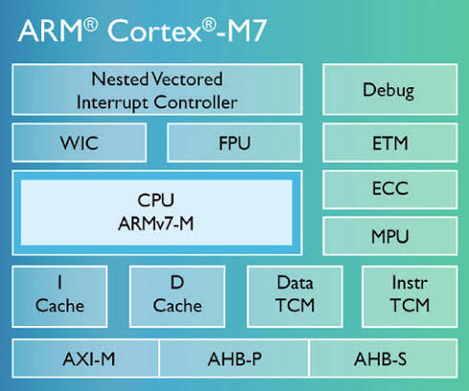
ARM Cortex-M Architecture
The Cortex-M architecture integrates the CPU core with memories, interrupt controller, and debugging features.

Slide 14
Comparison of ARM Cortex-M0, Cortex-M3, Cortex-M4, and Cortex-M7 Processors
Feature | Cortex-M0 | Cortex-M3 | Cortex-M4 | Cortex-M7
Architecture | ARMv6-M | ARMv7-M | ARMv7E-M | ARMv7E-M
CPU Type | 32-bit RISC | 32-bit RISC | 32-bit RISC | 32-bit RISC
Performance | Low | Medium | High | Very High
Pipeline | 3-stage | 3-stage | 3-stage | 6-stage superscalar
Clock Speed | Up to ~50 MHz | Up to ~120 MHz | Up to ~180 MHz | Up to ~600 MHz
DSP Instructions | No | No | Yes | Yes (Enhanced)
Floating Point Unit (FPU) | No | No | Optional Single Precision | Single Precision; optional Double Precision
Instruction Cache | No | No | No | Yes
Data Cache | No | No | No | Yes
Memory Protection Unit (MPU) | Optional | Yes | Yes | Yes
Interrupt Controller (NVIC) | Yes | Advanced | Advanced | Advanced
Power Consumption | Very Low | Low | Moderate | Moderate
Real-Time Performance | Good | Better | Excellent | Outstanding
Typical Applications | Sensors, wearables | Industrial control | Motor control, audio | Robotics, automotive, AI, industrial automation

Slide 15
STM32 ARM Cortex-M

Slide 16
The STM32 Nucleo Board is a low-cost, open-source development and prototyping board developed by STMicroelectronics. It is designed to help students, engineers, and developers learn, prototype, and develop embedded system applications using STM32 ARM Cortex-M microcontrollers.
The board includes an on-board ST-LINK debugger/programmer, allowing users to program and debug the microcontroller directly through a USB cable without requiring an external programmer.

Slide 17
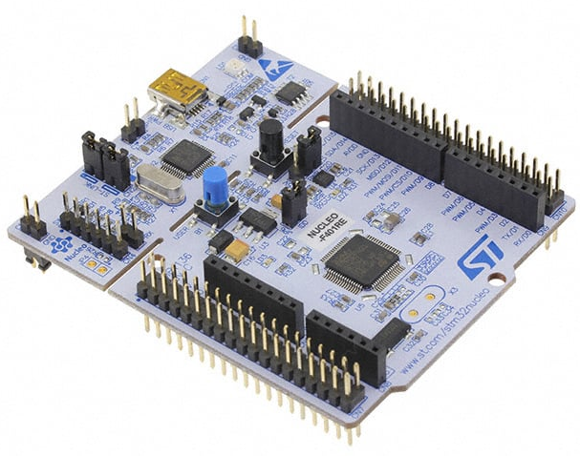

Slide 18
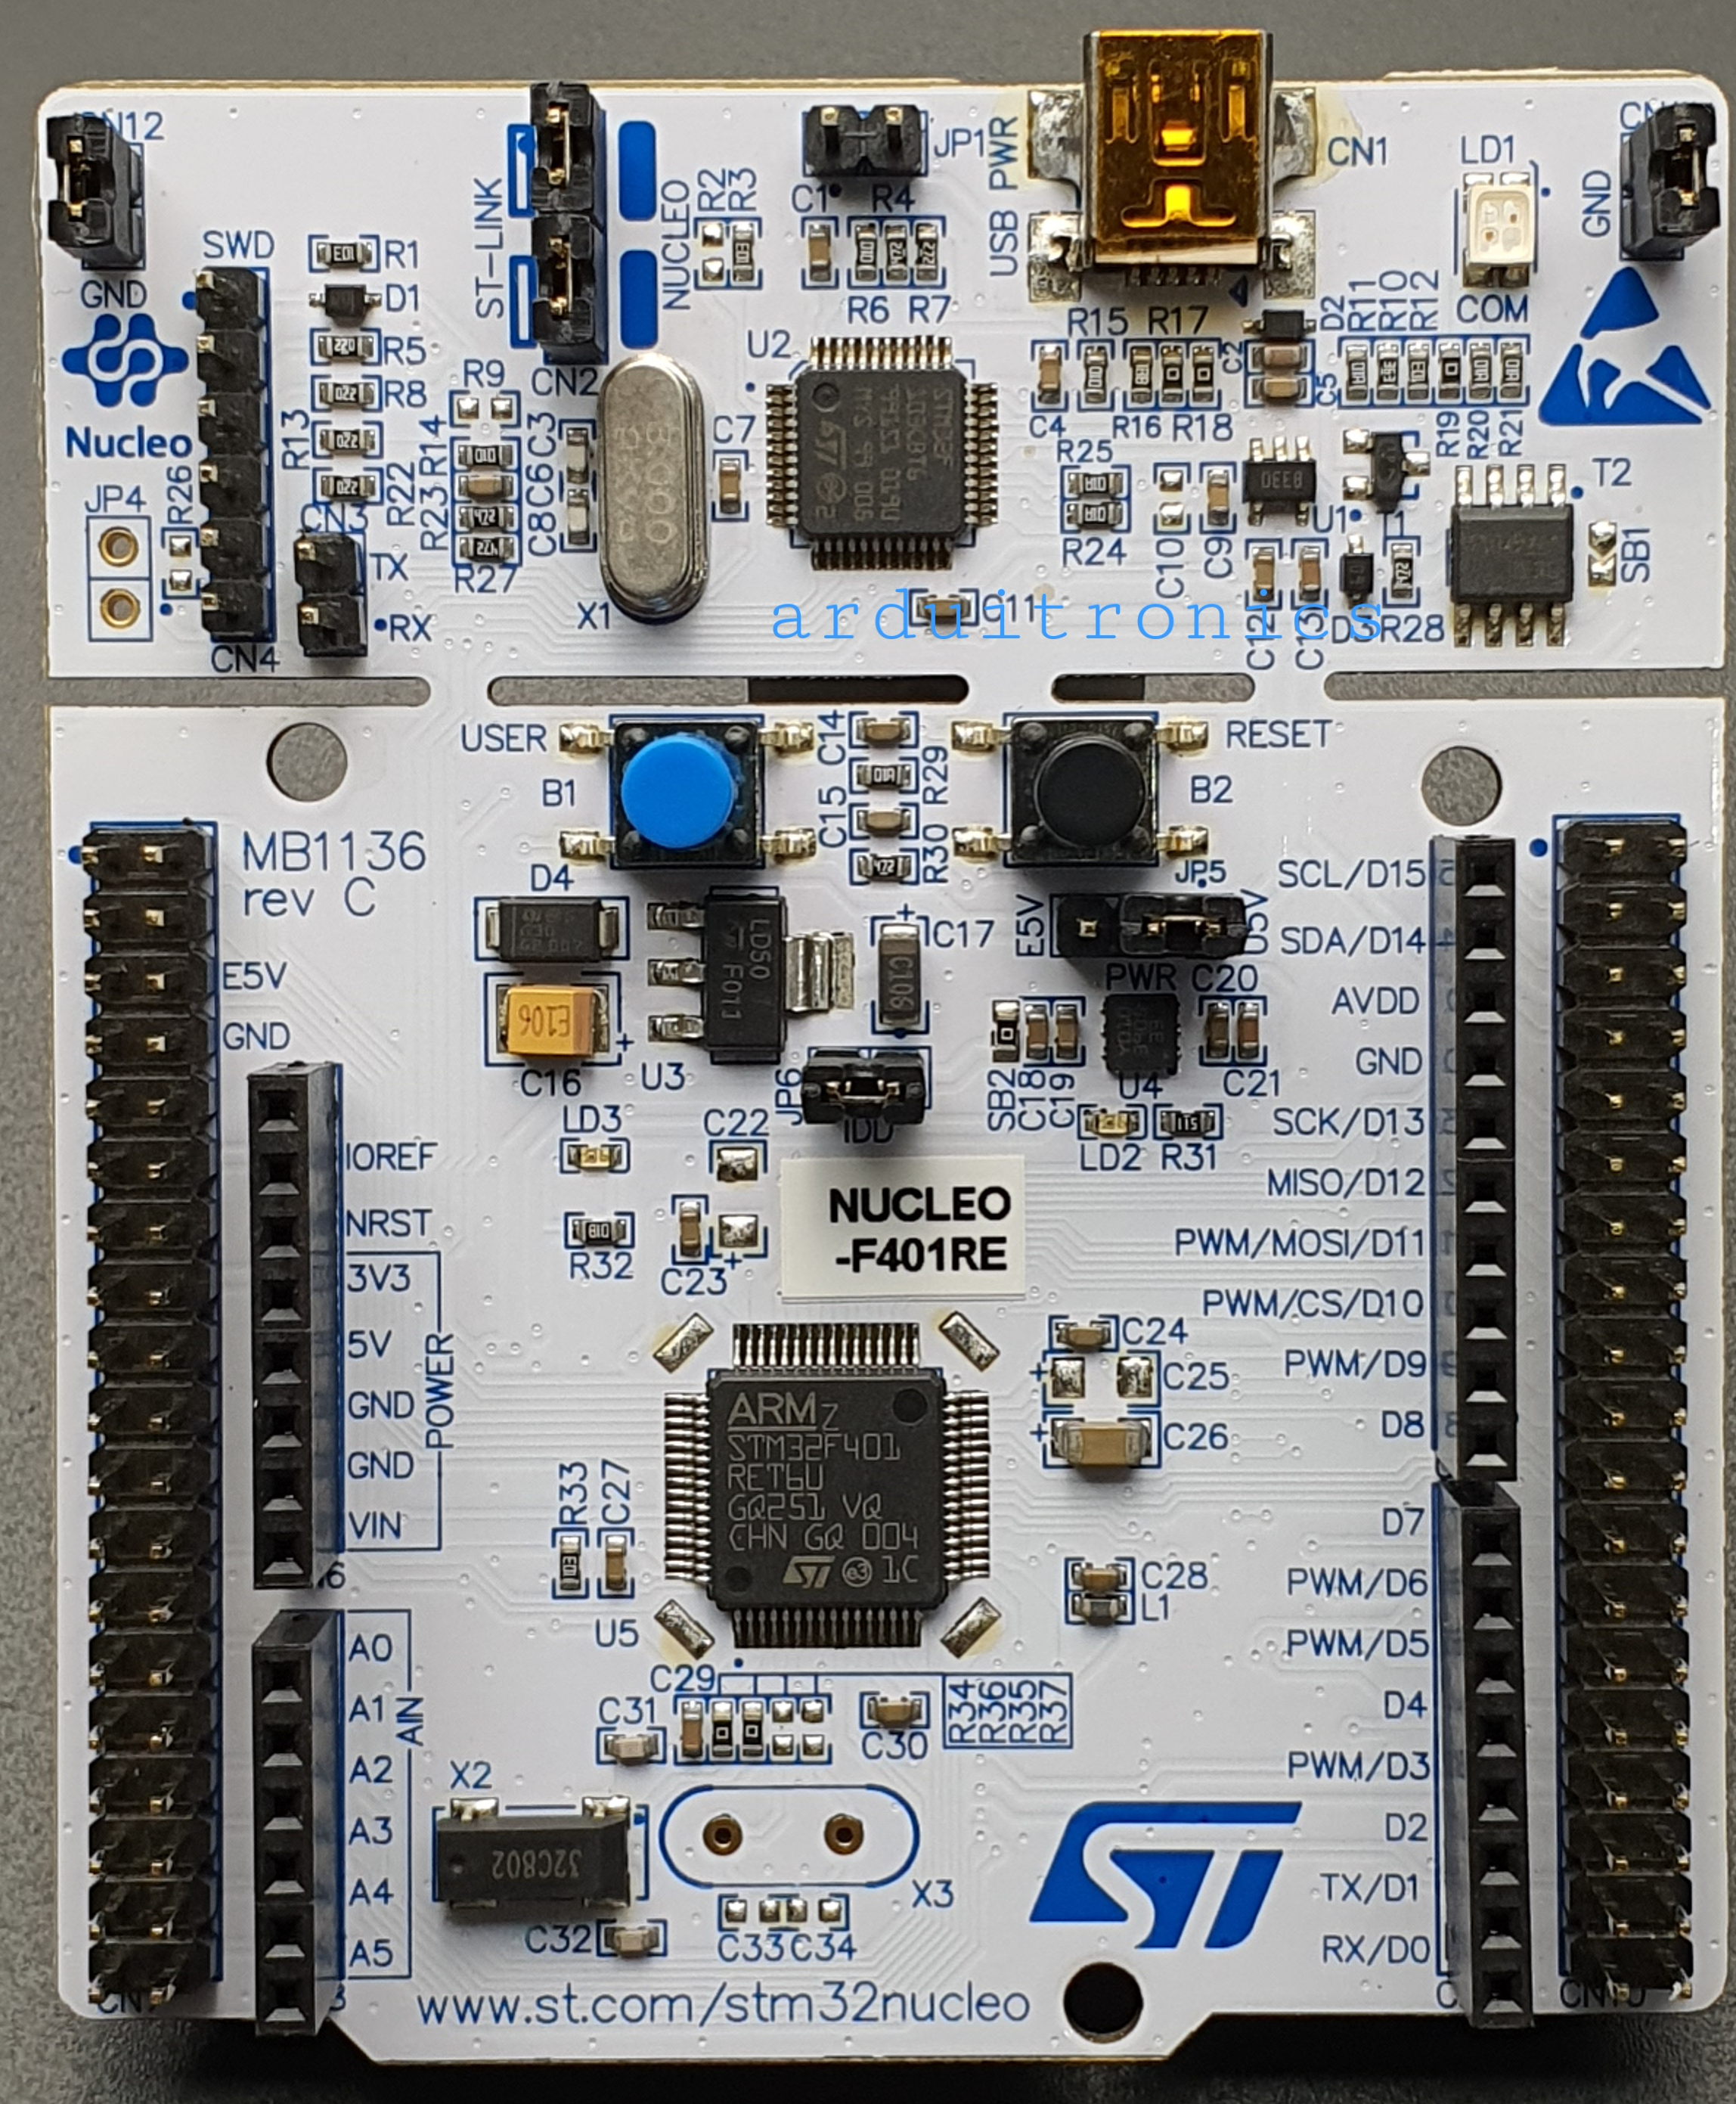

Slide 19
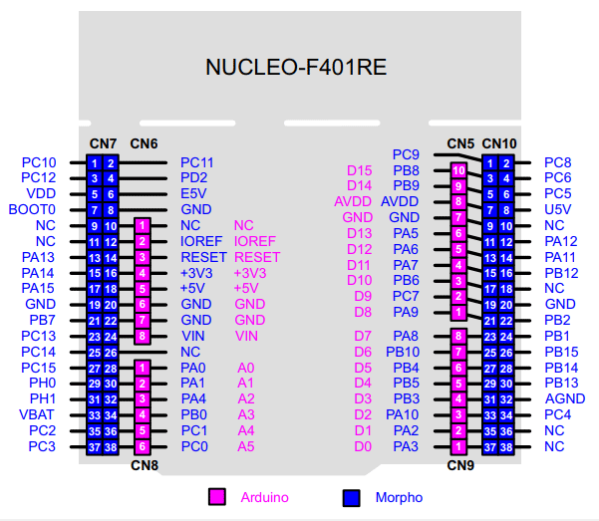

Slide 20
Main Features
STM32 ARM Cortex-M microcontroller (M0, M0+, M3, M4, M7, M33, etc., depending on the board)
On-board ST-LINK/V2-1 or ST-LINK/V3 debugger/programmer
USB interface for programming and power supply
Arduino Uno Rev3 compatible headers for expansion shields
ST Morpho headers for access to all MCU I/O pins
User LED for testing applications
User push button for user input
Reset button
3.3 V operating voltage
Compatible with STM32CubeIDE, Keil MDK, IAR Embedded Workbench, and Platform IO

Slide 21
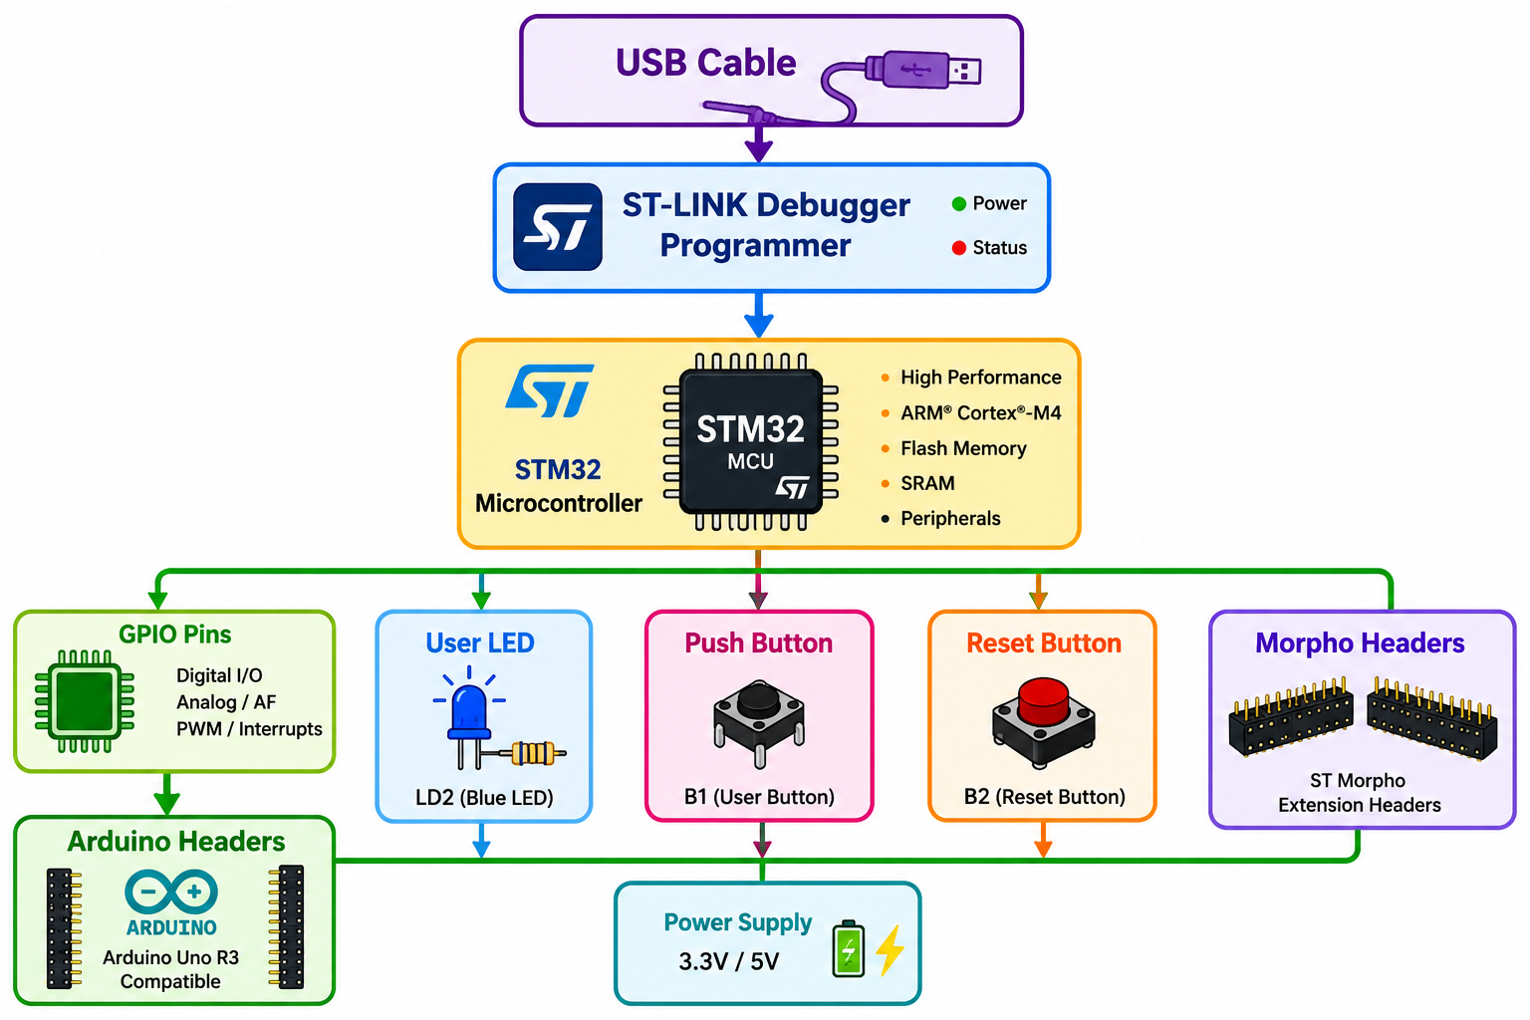

Slide 22
Major Components
Component | Description
STM32 MCU | Executes the embedded program.
ST-LINK | Programs and debugs the microcontroller through USB.
USB Connector | Supplies power and transfers programming/debugging data.
Arduino Headers | Allow Arduino-compatible shields to be connected.
Morpho Headers | Provide access to nearly all MCU pins.
User LED (LD2) | Used to test and indicate program status.
Power LED (LD3) | Indicates the board is powered.
User Button (B1) | Used as an input for applications.
Reset Button (B2) | Restarts the microcontroller.
Clock Circuit | Provides the clock signal required by the MCU.

Slide 23
Advantages
Low-cost development platform
Easy programming through USB
Built-in debugger (no external programmer required)
Supports many STM32 microcontrollers
Compatible with Arduino shields
Large software ecosystem and community support
Ideal for learning embedded systems and IoT development

Slide 24
Applications
Embedded system development
IoT device prototyping
Robotics
Industrial automation
Motor control
Sensor interfacing
Home automation
Data acquisition systems
Communication protocol development (UART, SPI, I²C, CAN, USB)

Slide 25
Common STM32 Nucleo Boards
Board | Microcontroller | Core
NUCLEO-F103RB | STM32F103RB | Cortex-M3
NUCLEO-F401RE | STM32F401RE | Cortex-M4
NUCLEO-F446RE | STM32F446RE | Cortex-M4
NUCLEO-L476RG | STM32L476RG | Cortex-M4 (Low Power)
NUCLEO-H743ZI | STM32H743ZI | Cortex-M7

Slide 26
Technical Specifications
Feature | Specification
Board Name | NUCLEO-F401RE
Microcontroller | STM32F401RET6
CPU Core | ARM Cortex-M4 with FPU
Maximum Clock Frequency | 84 MHz
Flash Memory | 512 KB
SRAM | 96 KB
Operating Voltage | 3.3 V
Input Supply Voltage | 5 V (USB) or external supply
Package | LQFP-64
GPIO Pins | Up to 51 GPIOs available on headers

Slide 27
Technical Specifications
Feature | Specification
ADC | 12-bit ADC (up to 16 channels, 2.4 MSPS)
DAC | Not available
Timers | 11 timers (16-bit and 32-bit)
RTC | Yes
DMA | Yes
CRC Unit | Yes
Cyclic Redundancy Check

Slide 28
Communication Interfaces
3 × USART/UART
3 × I²C
4 × SPI/I²S
USB 2.0 Full-Speed OTG
SDIO Interface
SWD (Serial Wire Debug)
JTAG Debug Support

Slide 29
On-Board Features
ST-LINK/V2-1 on-board programmer/debugger
USB connector for programming and power
1 User LED (LD2)
1 Power LED (LD3)
1 User Push Button (B1)
1 Reset Button (B2)
32.768 kHz crystal for RTC
Arduino Uno Rev3 compatible headers
ST Morpho extension headers for full access to MCU pins

Slide 30
Memory Map
Memory | Size
Flash | 512 KB
SRAM | 96 KB
Clock Sources
Internal High-Speed Oscillator (HSI)
Internal Low-Speed Oscillator (LSI)
External High-Speed Clock (supported)
32.768 kHz RTC crystal on the board

Slide 31
Development Software
The NUCLEO-F401RE supports:
STM32CubeIDE
STM32CubeMX
Keil MDK-ARM
IAR Embedded Workbench
Platform IO
GCC ARM Embedded Toolchain

Slide 32
GPIO Ports
STM32 organizes GPIO pins into ports.
Example:
GPIOA
GPIOB
GPIOC
GPIOD
GPIOE
GPIOH (only 2 pins H1 and H2)
Each port contains up to 16 pins numbered 0–15.

Slide 33
Feature | Description | Advantages | Applications
Pipeline Architecture | 6-stage superscalar pipeline with dual-issue capability | Higher instruction throughput and faster execution | Robotics, industrial automation
Cache Memory | Separate Instruction Cache (I-Cache) and Data Cache (D-Cache) | Faster memory access and improved performance | Embedded systems, IoT, automotive
Floating-Point Unit (FPU) | Hardware support for floating-point arithmetic | Faster and more accurate mathematical operations | Scientific computing, robotics, medical devices
DSP Instructions | MAC, SIMD, saturation arithmetic, bit manipulation | High-speed signal processing | Audio, image processing, motor control
Interrupt Latency | Fast response using NVIC with automatic context handling | Predictable, low-latency interrupt servicing | Real-time control, automotive ECUs, industrial systems

Slide 34
Advanced Features of Cortex-M7
1. Six-Stage Pipeline
Stages
Fetch Instruction (FI) - Fetch
Decode Instruction (DI) - Decode
Calculate Operand (CO) – Issue
Fetch Operand(FO) – Execute
Execute Instruction (EI) – Memory Access
Write Operand (WO) – Write Back
Advantages
High throughput
Multiple instructions processed simultaneously
Increased clock frequency
Better CPU utilization

Slide 35
2. Harvard Architecture
Separate buses
Instruction Bus
Data Bus
Advantages
Simultaneous instruction fetch and data access
Faster execution, Reduced bottleneck
3. Branch Prediction
Predicts
Whether a branch instruction will be taken.
Advantages
Reduces pipeline stalls
Improves execution speed

Slide 36
4. Cache Memory
Two independent caches
I-Cache (Instruction Cache): Stores recently executed instructions.
D-Cache (Data Cache): Stores frequently accessed data.
Typical size
16 KB
32 KB
64 KB
Advantages
Faster memory access
Reduced Flash access time
Increased processor speed

Slide 37
5. TCM
Tightly Coupled Memory
Types
ITCM (Instruction TCM)
DTCM (Data TCM)
Advantages
Zero wait-state memory
Predictable execution
Suitable for real-time applications
6. FPU
Floating Point Unit
Supports
Single Precision (32-bit), Double Precision (64-bit) (implementation dependent)
Advantages
Faster mathematical operations, Scientific calculations, Control algorithms, Robotics,
Sensor fusion
Example: Without FPU Floating multiplication, Software execution are slow
With FPU: Hardware execution Very Fast

Slide 38
7. DSP Instructions
Digital Signal Processing
Dedicated instructions
MAC (Multiply Accumulate)
Saturation Arithmetic
SIMD (Single Instruction Multiple Data)
Applications
Audio processing
Image processing, Motor control
FFT, FIR filters
Example
A = A + B × C
Executed in a single instruction.
8. DMA Support
Direct Memory Access
Transfers data
Memory ↔ Peripheral
Without CPU involvement.
Advantages
Faster communication
Reduced CPU load

Slide 39
9. ECC
Error Correction Code
Used in
Flash
SRAM
Advantages
Detects memory errors
Corrects single-bit errors
Improves reliability

Slide 40
Pipeline Architecture
Pipeline divides instruction execution into several stages. Instead of completing one instruction before starting another Multiple instructions are processed simultaneously.
Example: Clock Cycle
Instruction 1 Fetch
Instruction 2 Fetch
Instruction 3 Fetch
Meanwhile
Instruction 1 Decode
Instruction 2 Decode
Instruction 1 Execute
...
Advantages
Higher throughput
Increased processor utilization
Higher clock frequency
Better overall performance

Slide 41
Cache Memory
A small high-speed memory placed between CPU and main memory.
Purpose
Reduce memory access time.
Types
Instruction Cache
Data Cache
Benefits
Faster program execution
Reduced Flash accesses
Lower execution time

Slide 42
Floating Point Unit (FPU)
Purpose
Hardware accelerator for floating-point operations.
Operations
Addition, Multiplication, Division, Square Root, Trigonometric calculations
Applications
Robotics
AI
Image processing
Motor control
Biomedical devices

Slide 43
DSP Instructions
Purpose
Accelerate signal processing algorithms.
Common DSP Operations
FIR Filter
FFT
Matrix Multiplication
Audio Compression
Image Enhancement

Slide 44
Interrupt Latency
Interrupt latency is the time taken by the processor to respond to an interrupt after the interrupt request is generated.
Formula: Interrupt Latency = Time from Interrupt Request to Execution of First Interrupt Instruction
Factors affecting latency
Pipeline stages, Cache misses, Memory wait states, Interrupt priority, Nested interrupts
Cortex-M7 Features
Very low interrupt latency
NVIC support
Tail chaining
Late arrival optimization

Slide 45
Tail Chaining
When one ISR finishes, the processor immediately services another pending interrupt Without restoring the previous context.
Advantages
Faster interrupt servicing, Reduced overhead
Late Arrival
If a higher-priority interrupt arrives while entering a lower-priority ISR, the processor immediately switches to the higher-priority interrupt.
Benefits
Faster response
Improved real-time performance

Slide 46
Important Abbreviations
Abbreviation | Full Form
ARM | Advanced RISC Machines
RISC | Reduced Instruction Set Computer
CPU | Central Processing Unit
MCU | Microcontroller Unit
NVIC | Nested Vectored Interrupt Controller
FPU | Floating Point Unit
DSP | Digital Signal Processing
MPU | Memory Protection Unit
DMA | Direct Memory Access
TCM | Tightly Coupled Memory
ITCM | Instruction Tightly Coupled Memory
DTCM | Data Tightly Coupled Memory
SRAM | Static Random Access Memory
Flash | Flash Memory (Non-Volatile Memory)
I-Cache | Instruction Cache
D-Cache | Data Cache
ISR | Interrupt Service Routine
RTOS | Real-Time Operating System
JTAG | Joint Test Action Group (debug interface)
SWD | Serial Wire Debug
ECC | Error Correction Code
SIMD | Single Instruction Multiple Data
MAC | Multiply-Accumulate
FIR | Finite Impulse Response
FFT | Fast Fourier Transform
ECU | Engine Control Unit
ADC | Analog-to-Digital Converter
DAC | Digital-to-Analog Converter
GPIO | General Purpose Input/Output

